Slide 1
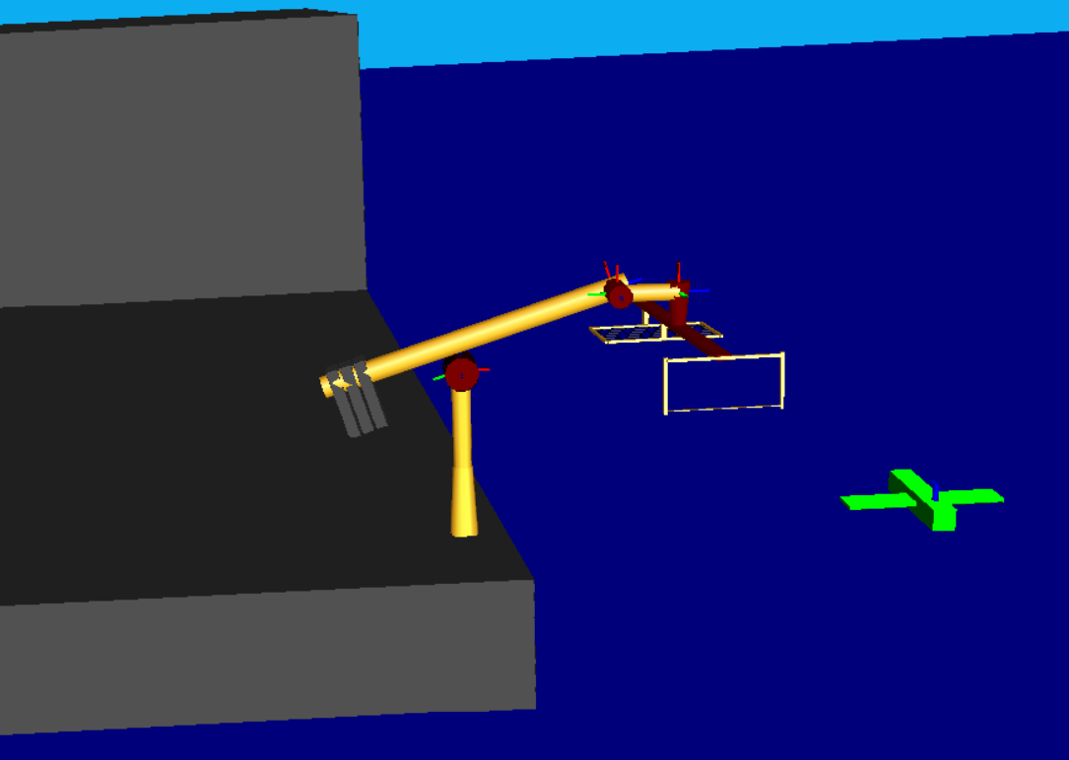
Drone Recovery Robot
Matt Kennedy
John Furumo
Snapshot of Robot Model
from RoboWorks

Slide 2
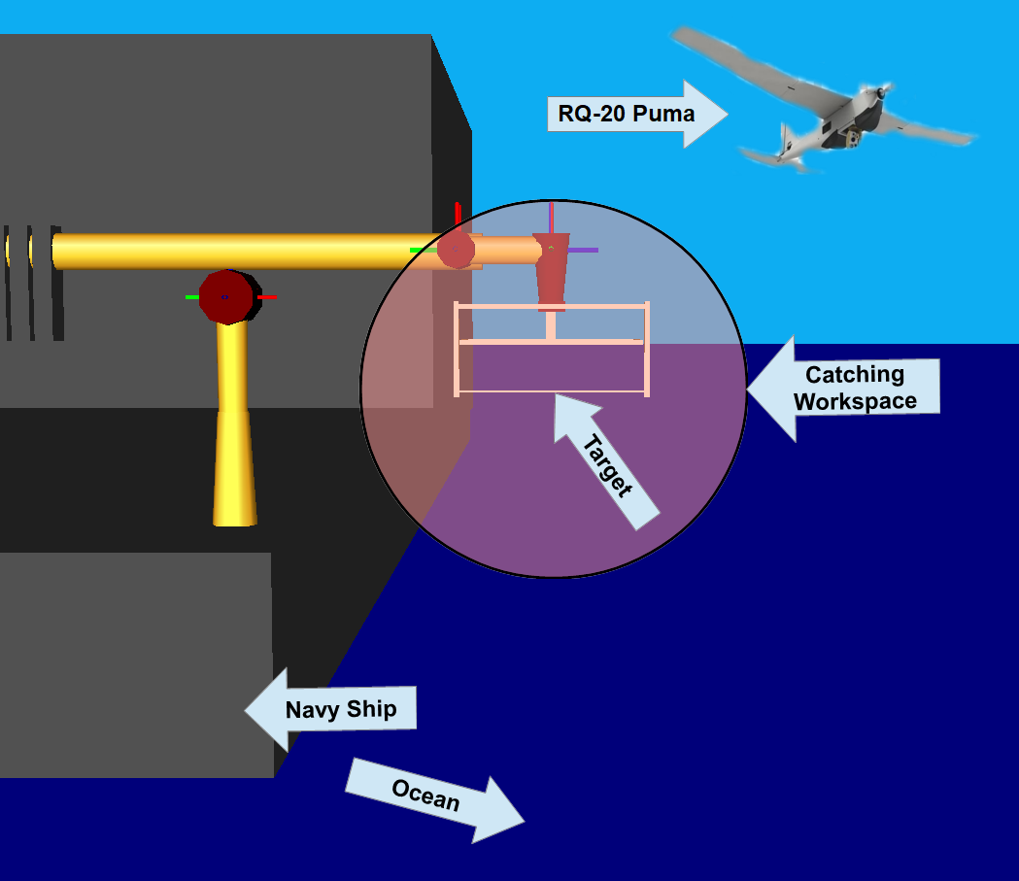
Robotic Task (Description)
9-DEC-2019
2
ENAE692/Robot Project
Notes:
2

Slide 3
Robotic Task (Requirements)
Kinematic Requirements
Position DOFs/Range
Orientation DOFs/Range
Workspace Requirements
Reachable (tool position)
Dexterous (tool orientation)
Force Requirements
Force (x-y-z)
Moment (Mx-My-Mz)
Other
Obstacle Avoidance

Slide 4
Robot Design (Specifications)
Description | Specification
Total Degrees of Freedom | 7
Arm Type* | DYPDPRY
Wrist Type† | PRY (IAW-No)
Redundancy | elbow orbit angle
Length Sum (L) | 50 cm
Structural Length Index (Q) | 1.8
*R=roll, P=pitch, Y=yaw, D=prismatic
†IAW-intersecting axis wrist

Slide 5
Robot Design (Link Frames)
Θ₂
d4
x4
Top View
z1, z2, x3
x1,x2
z4
a4
Θ₇
x5
z7
z6
Θ₃
z3
Θ₅
Θ₆
z5
x6,x7
z1, z2, x3
z7
x4,x5
d4
Θ₅
Θ₇
Θ₃
Side View
x1,x2
z4
z6
z3
z5
x6,x7
Θ₆
Θ₂
d1
z0
tern device
θ_{ΗΟΜΕ}=[2.5m, 0 rad, π/2 rad, 2.5m, 0, 0, 0]^{T}
x0

Slide 6
Robot Design (D-H Table)
i | α_{i-1} (deg) | a_{i-1} (m) | d_{i} (m) | θ_{i} (deg) | JL⁻ (deg) | JL⁺ (deg)
1 | 0 | 0 | d1 | 0 | 2.5m | 3.75m
2 | 0 | 0 | 0 | Θ₂ | -180 | 180
3 | 90 | 0 | 0 | Θ₃ | 45 | 135
4 | 90 | a3 | d4 | 0 | 2.5m | 3.75m
5 | -90 | a4 | 0 | Θ₅ | -45 | 45
6 | 90 | 0 | 0 | Θ₆ | -22.5 | 22.5
7 | 90 | 0 | 0 | Θ₇ | -45 | 225
JL = JOINT LIMIT

Slide 7
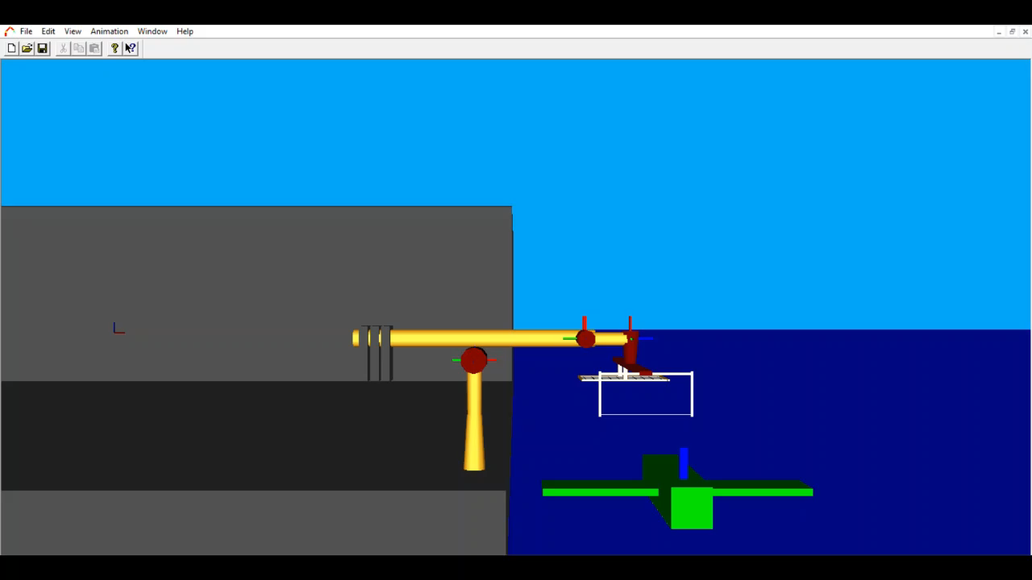
Robot Design (Joint Animation)
My Awesome Robot
(Show the motion of each joint in RoboWorks)

Slide 8
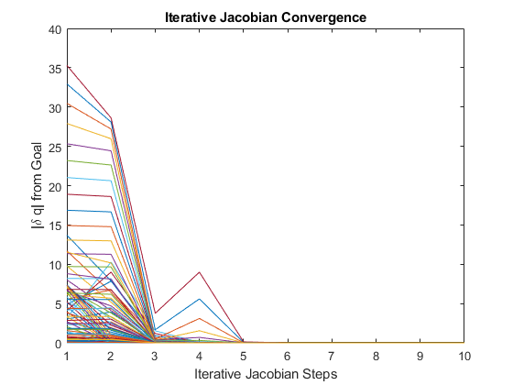
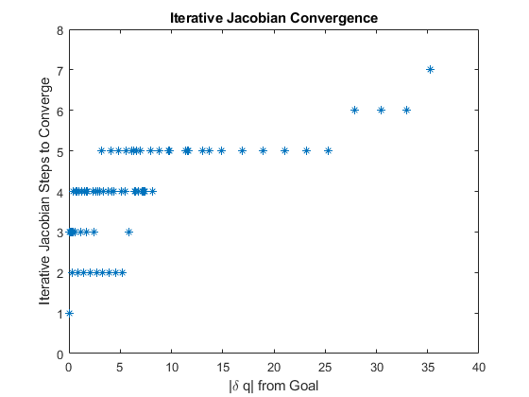
Inverse Kinematics (Solution)

Slide 9

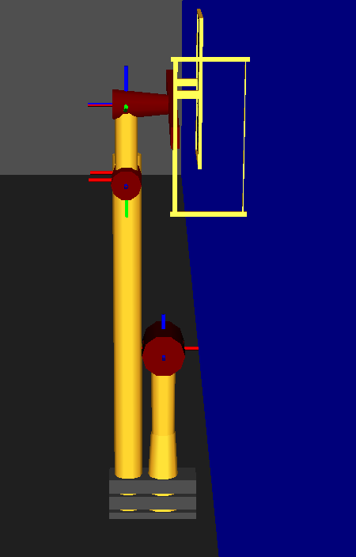
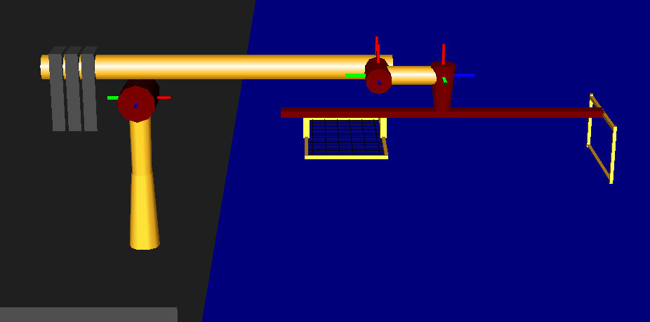
Singularities
Internal:
Boundary:
linearly dependent columns
9-DEC-2019
9
ENAE692/Robot Project

Slide 10
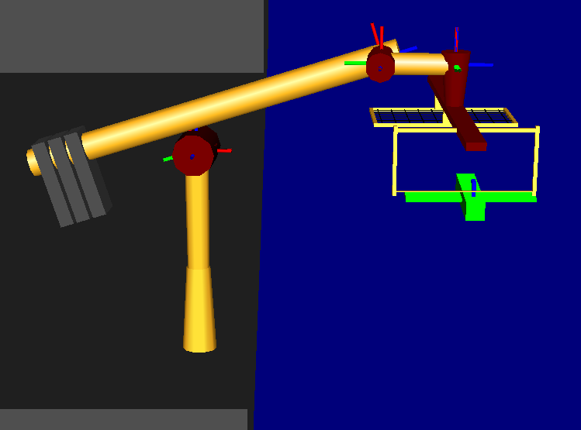
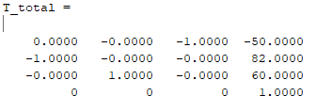
Maximum Load
Maximum Task Force/Torque:
F_{MAX} = [0, 300N, 0], N_{MAX} = [0,0,0]
Workspace Pose:
Joint Position:
q_{T}= [50.77,1.57,1.75,50.84,-0.18,0,-1.57]
Force
τ = J*F=[0,-15000,-6369,295,
-3600,15000,15000]
ϑ^{Τ}(θ)
(Joint Torques)
9-DEC-2019
10
ENAE692/Robot Project

Slide 11
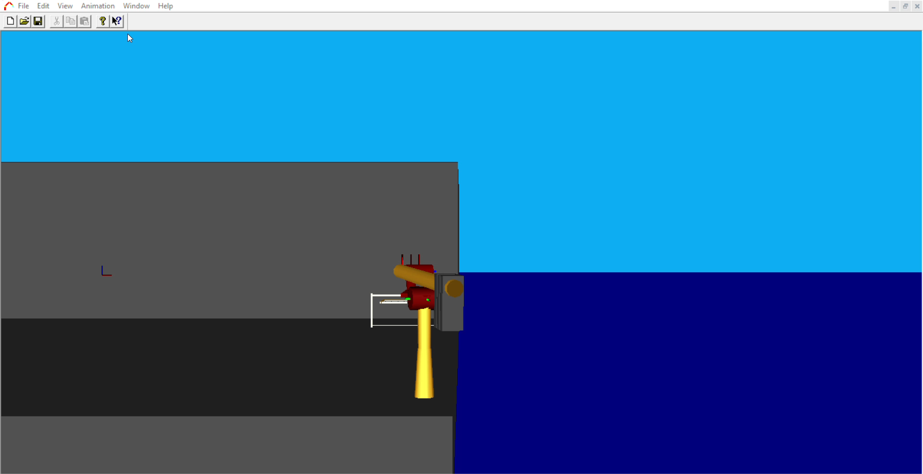
Task (Animation)
Task Animation
(Show task execution in RoboWorks)
*Note: required for teams of 2

Slide 12
Conclusions
Robot Design
Workspace adequate?
Singularities a problem?
Kinematic Redundancy?
Future Work
Improvements?
Other Potential Applications?
What I Learned
About Design
From Building RoboWorks Model

Slide 13
Back-up

Slide 14
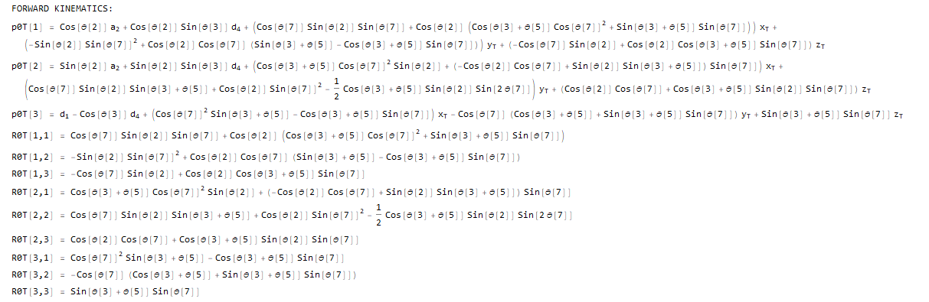
Forward Kinematics
9-DEC-2019
14
ENAE692/Robot Project

Slide 15
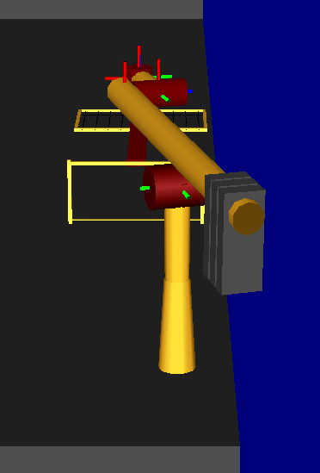
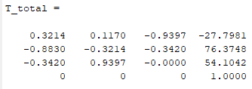
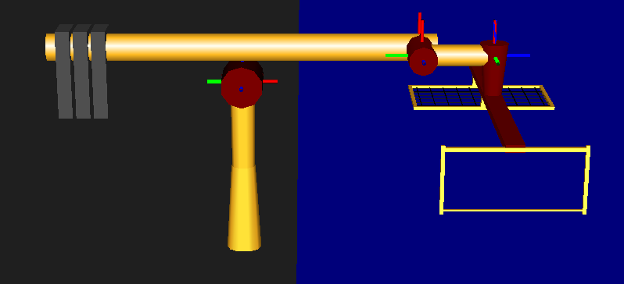
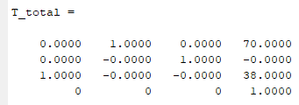
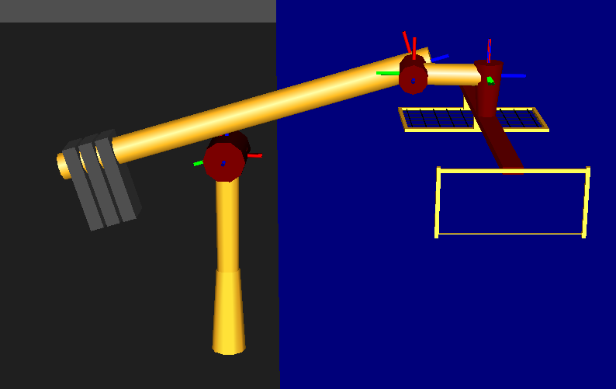
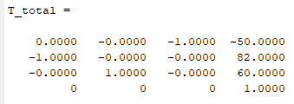
Forward Kinematics (Test)
q = [50,1.92,1.57,50,0,0,-1.92]
p0T=
R0T=
q = [50,0,1.57,50,0,0,0]
p0T=
R0T=
q = [50.8,1.57,1.75,50.85,-0.18,0,-1.57]
p0T=
R0T=
snapshot
9-DEC-2019
15
ENAE692/Robot Project
Notes:
15

Slide 16
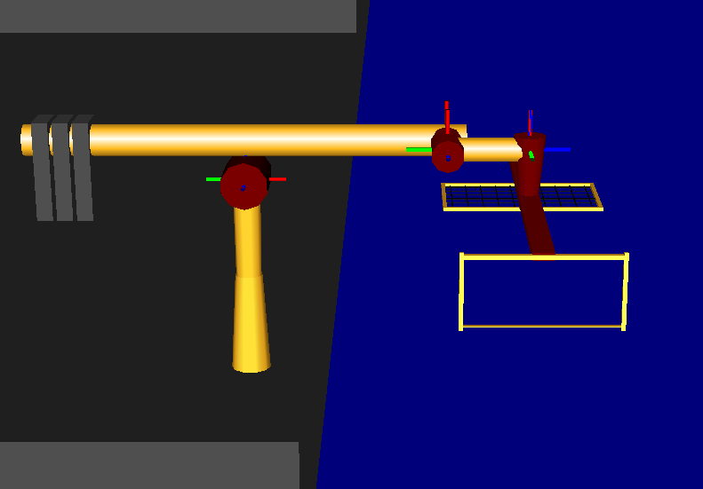
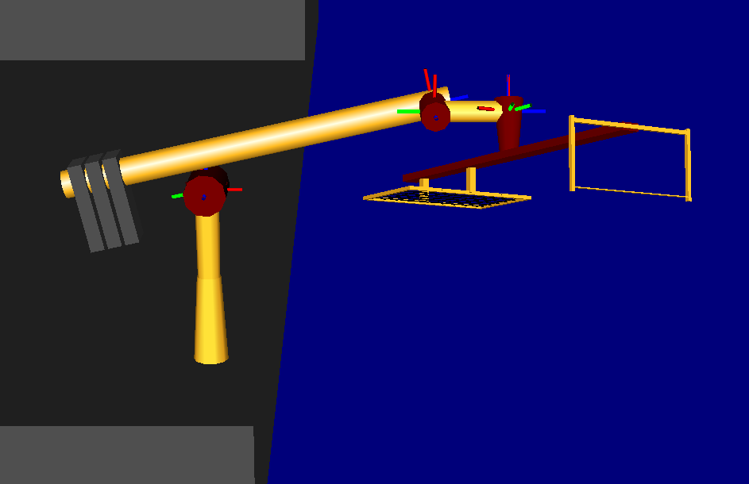
Inverse Kinematics (Test)
q_{START} = [50,0,pi/2,50,0,0,0]
⁰p_{GOAL}= [65,65,65],
⁰R_{GOAL}= [pi/8,-pi/8,0]=[yaw,pitch,roll]
show start configuration
Solution:
Q_{GOAL} = [50.84,0.32,2.09,72.63,-0.52,-0.39,0.077]
show end configuration
Solution Check:
⁰p_{T} (q_{GOAL}) = [65,65,65]
9-DEC-2019
16
ENAE692/Robot Project

Slide 17
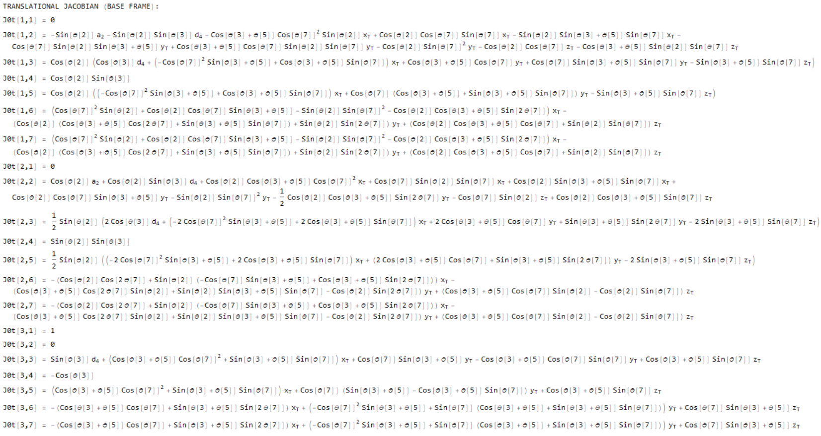
Translational Jacobian (Base Frame)

Slide 18
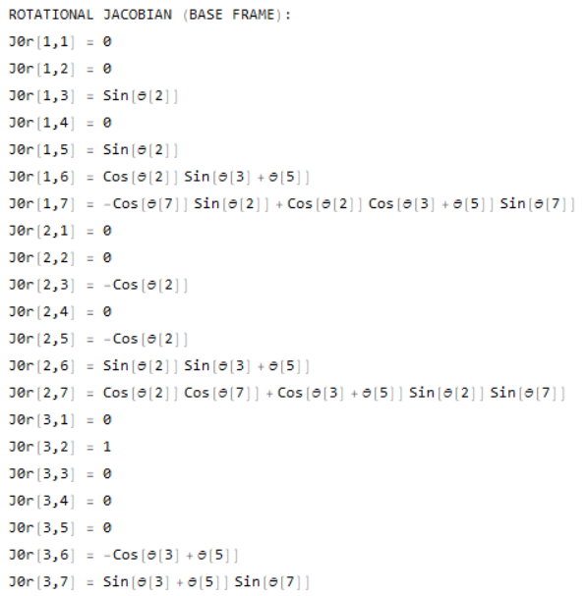
Rotational Jacobian (Base Frame)

Slide 19
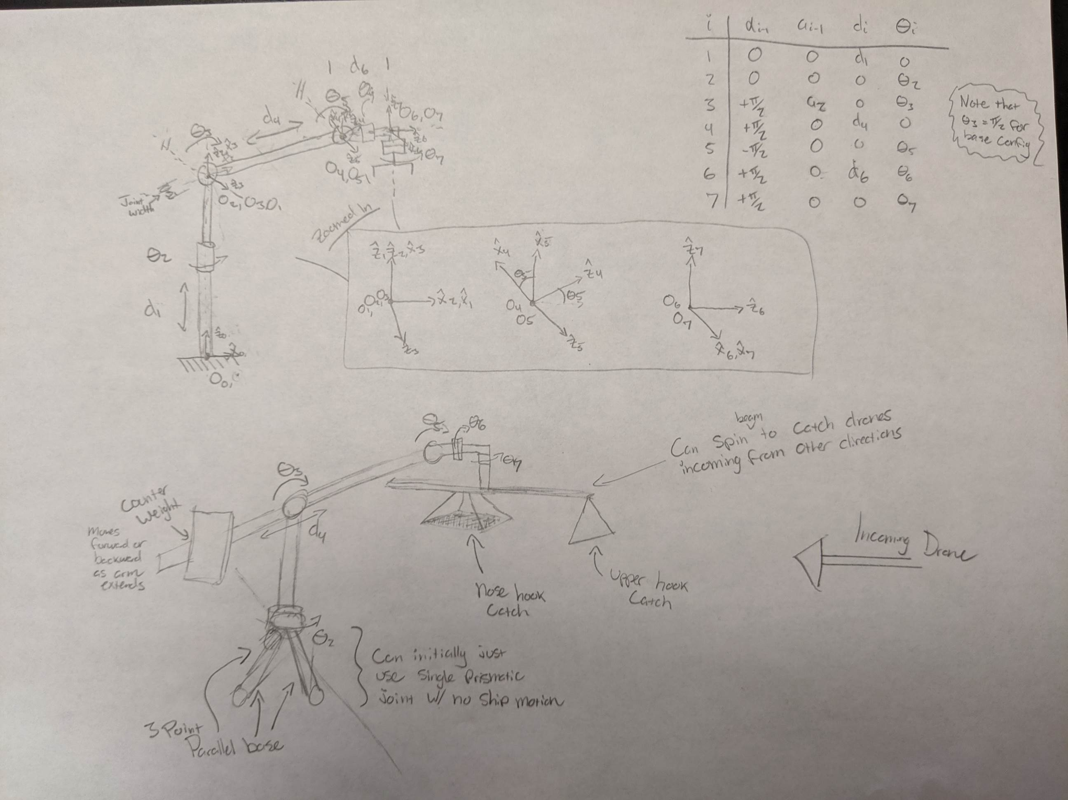

Slide 20
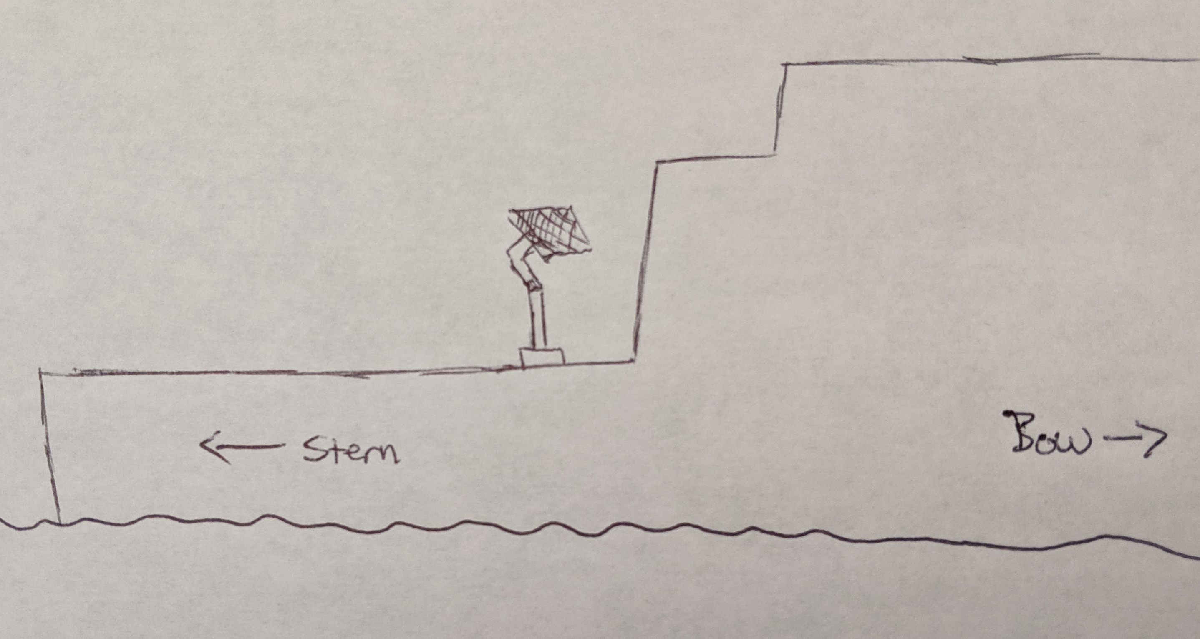
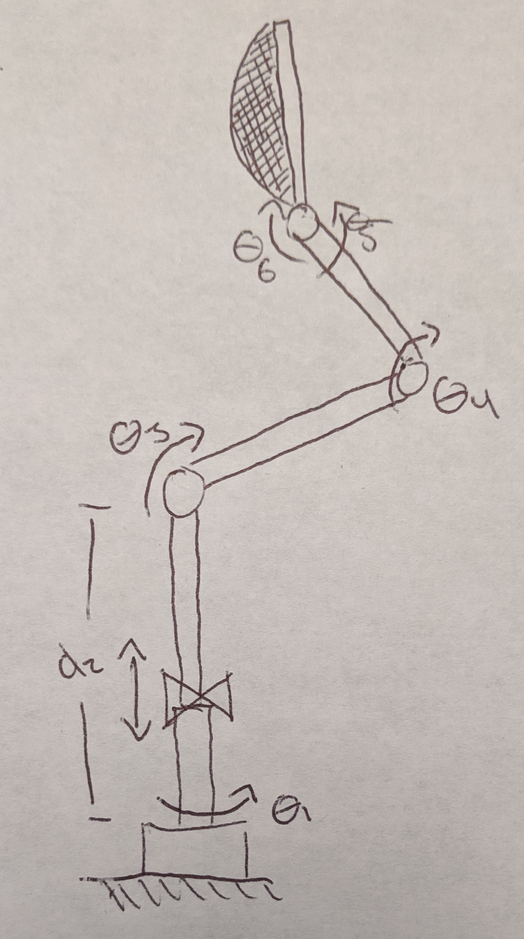
Drone Recovery Arm
Team: Matt Kennedy
John Furumo
Objective:
Design a manipulator capable of safely recovering both fixed wing and rotary drones to an underway ship.
Motivation:
• Facilitate drone recovery in all weather
• Facilitate drone recovery to all ship types
Task Requirements:
Kinematics
3 DOF to orient the catching mechanism
3 DOF to adjust height and stabilize tool tip
Workspace
Orient catching mechanism to 1m (width) by 2m (height) target area
Lower catching mechanism to ground for drone removal
Force/Moment
Impact with 40kg drone moving 10m/s (for fixed wing)
Drone Recovery Arm mounted to LCS Flight Deck
Robot Design:
Initial concept uses 5 revolute joints for positioning and orientation, and a prismatic joint near the base for additional stabilization.
The estimated required arms lengths are:
D2 = 2-3m
L3 = 1m
L4 = 1m
Though design requirements will be further investigated for optimal workspace to ensure safe wave-offs. The end-effector catching mechanism is initially proposed to be a simple net, though the effectiveness of others will be investigated.
23-OCT-2019
Notes:
20

